Slide 1



Endoscopic Sleeve Gastroplasty:
Integrated
in the treatment algorithm of Obesity
Christine Stier
University of Heidelberg, Mannheim Campus

Slide 2

CONFLICT OF INTEREST STATEMENT
Consultancy for various companies in the bariatric field:
Boston Scientific, USGI, Morphic Medical, USGI, Medtronic, Intuitive

Slide 3
FROM EVOLUTION TO INTERVENTION
Understanding biological drives to modifying the signals that control them

Slide 4
THE GUT-BRAIN AXIS – A COMPLEX COMMUNICATION NETWORK
Created by Evolution

Slide 5
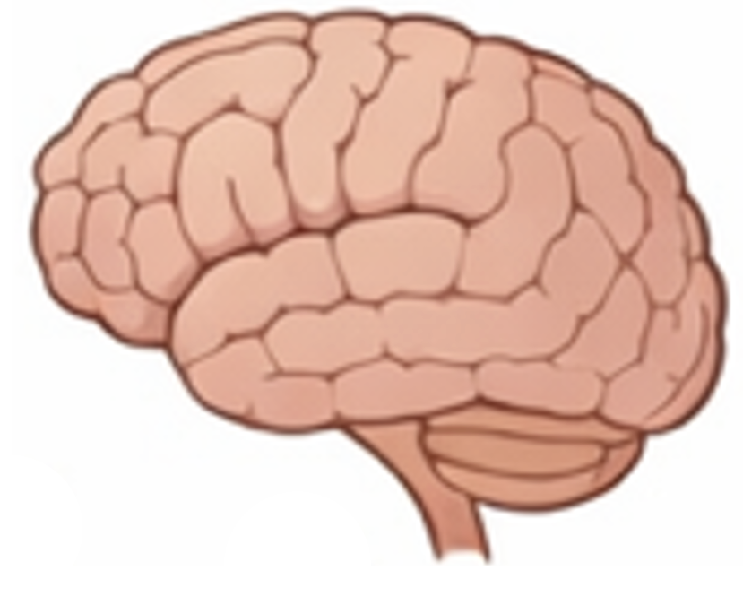
THE METABOLIC ORCHESTRATION
“Energy Intake”
BRAIN FIRST
© C. Stier
Kirkcaldie MT, Kitchener PD. When brains expand: mind and the evolution of cortex. Acta Neuropsychiatr. 2007 Jun;19(3):139-48.

Slide 6
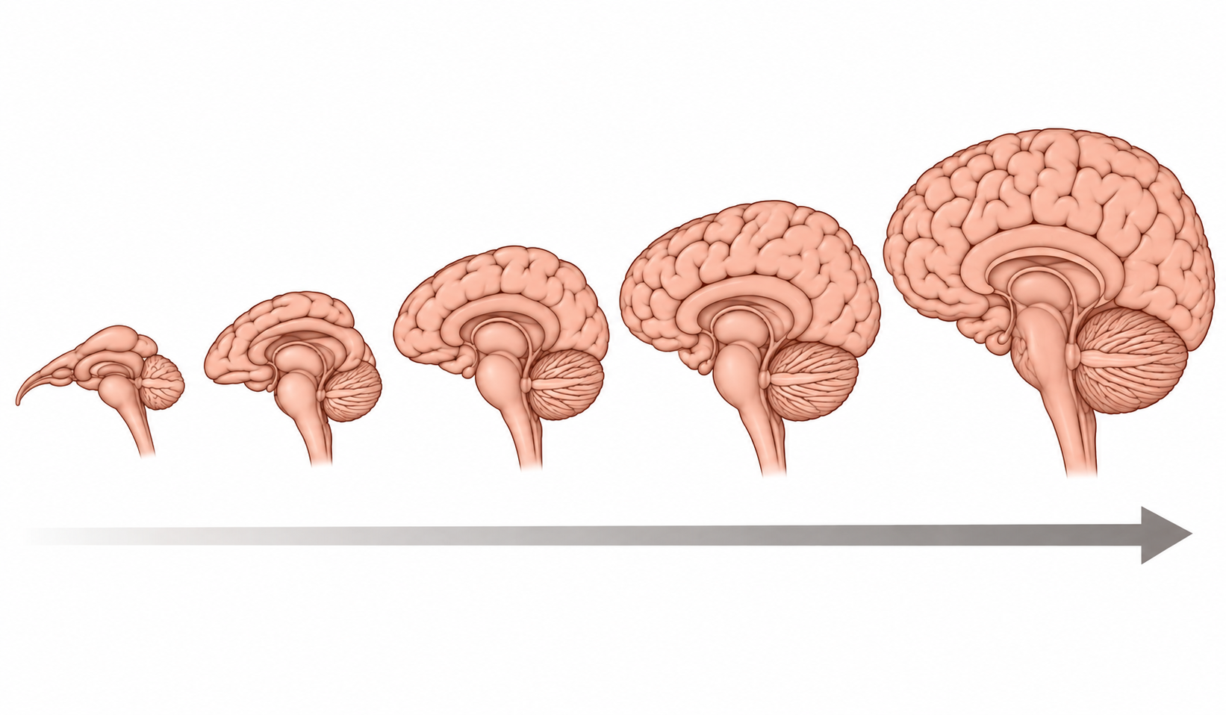
THE METABOLIC ORCHESTRATION
“Energy Intake”
“MASTERPIECE OF EVOLUTION”
© C. Stier
The neocortex could evolve to extraordinary complexity because survival-critical functions — breathing, energy homeostasis, and sleep — were never left to conscious control.
Kirkcaldie MT, Kitchener PD. When brains expand: mind and the evolution of cortex. Acta Neuropsychiatr. 2007 Jun;19(3):139-48.

Slide 7
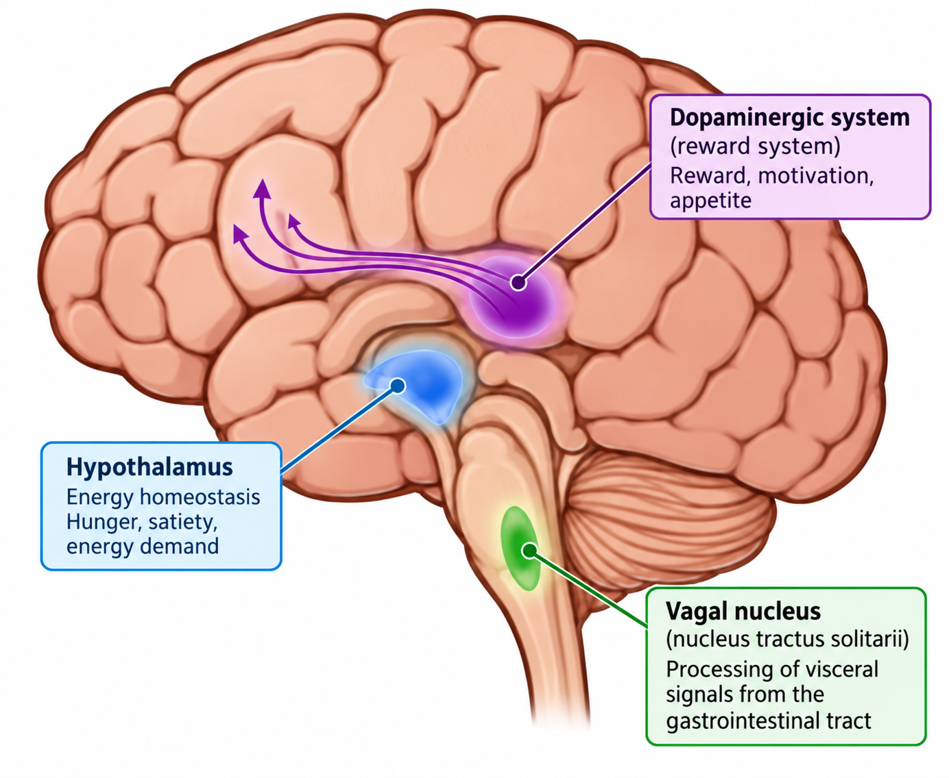
THE METABOLIC ORCHESTRATION
“Energy Intake”
© C. Stier
Fundamental survival functions are distributed across distinct evolutionarily ancient brain nuclei - not the neocortex -.
Kirkcaldie MT, Kitchener PD. When brains expand: mind and the evolution of cortex. Acta Neuropsychiatr. 2007 Jun;19(3):139-48.

Slide 8
THE METABOLIC ORCHESTRATION
“Energy Intake”
BRAIN FIRST
The Gut–Brain Axis is a
Bidirectional but Hierarchical Communication Network
Linking the Gastrointestinal Tract and the Central Nervous System
The Brain Dictates the Engery Demand
Stier C, Chiappetta S, Kermansaravi M. A Physiological Model of Incretin-Based Therapies and Hierarchical Energy Allocation Across Metabolic Phenotypes. Diabetes Obes Metab. 2026 Aug;28(8):7652-7657.

Slide 9
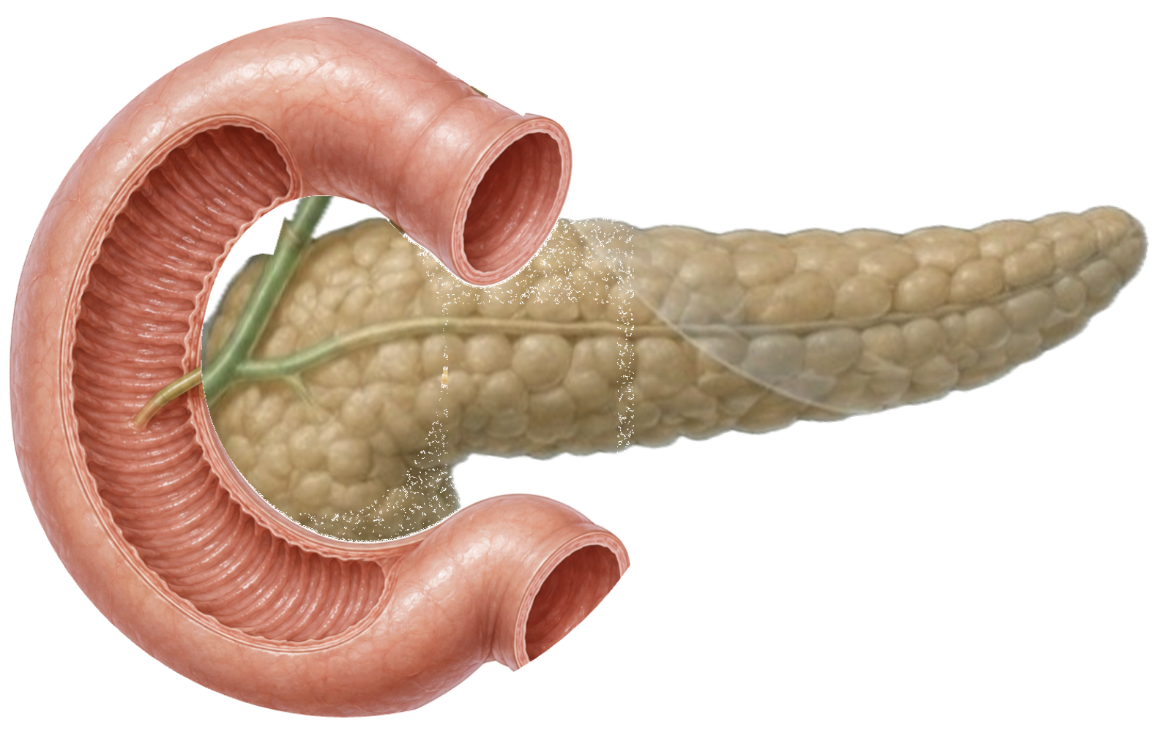
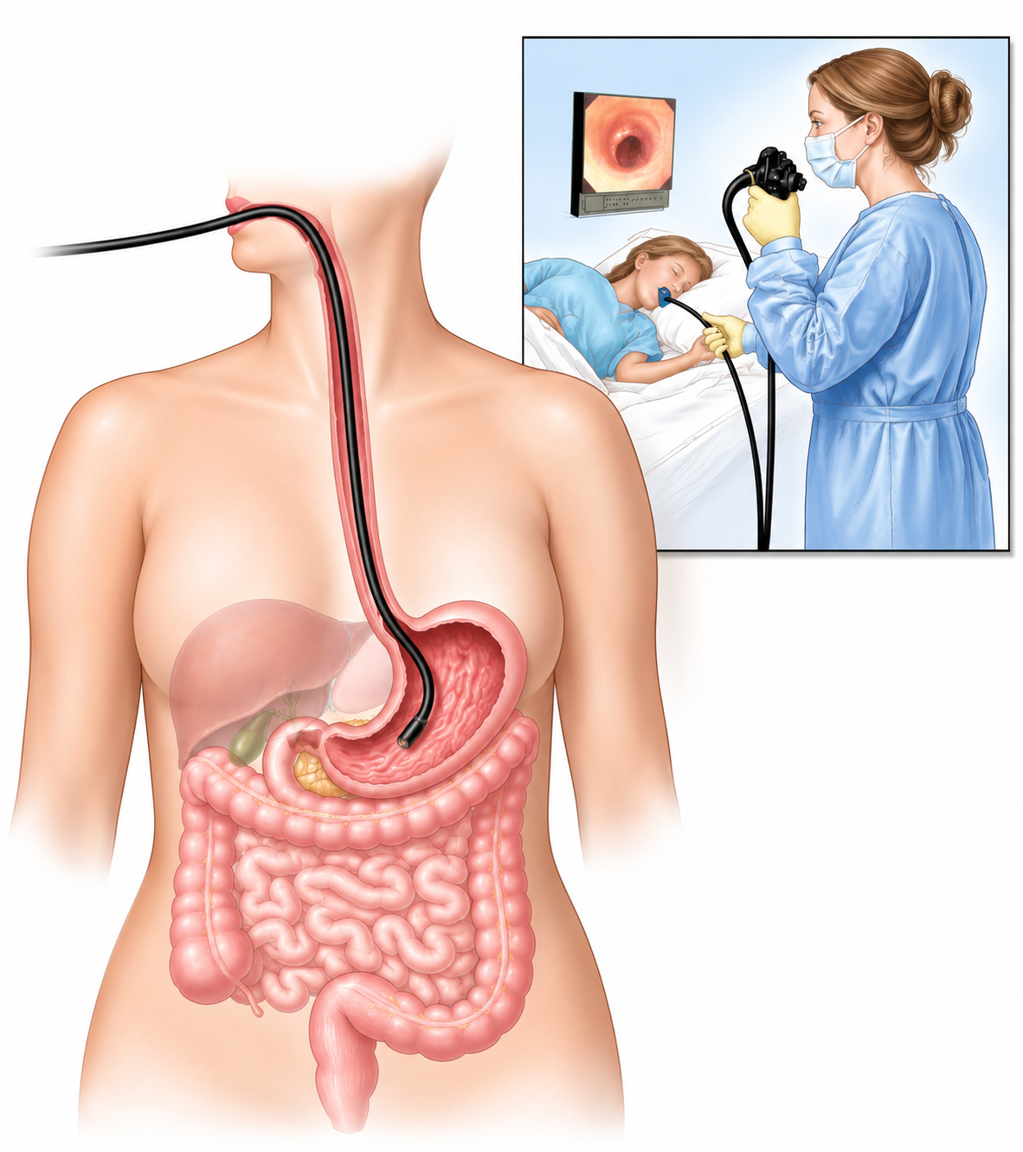
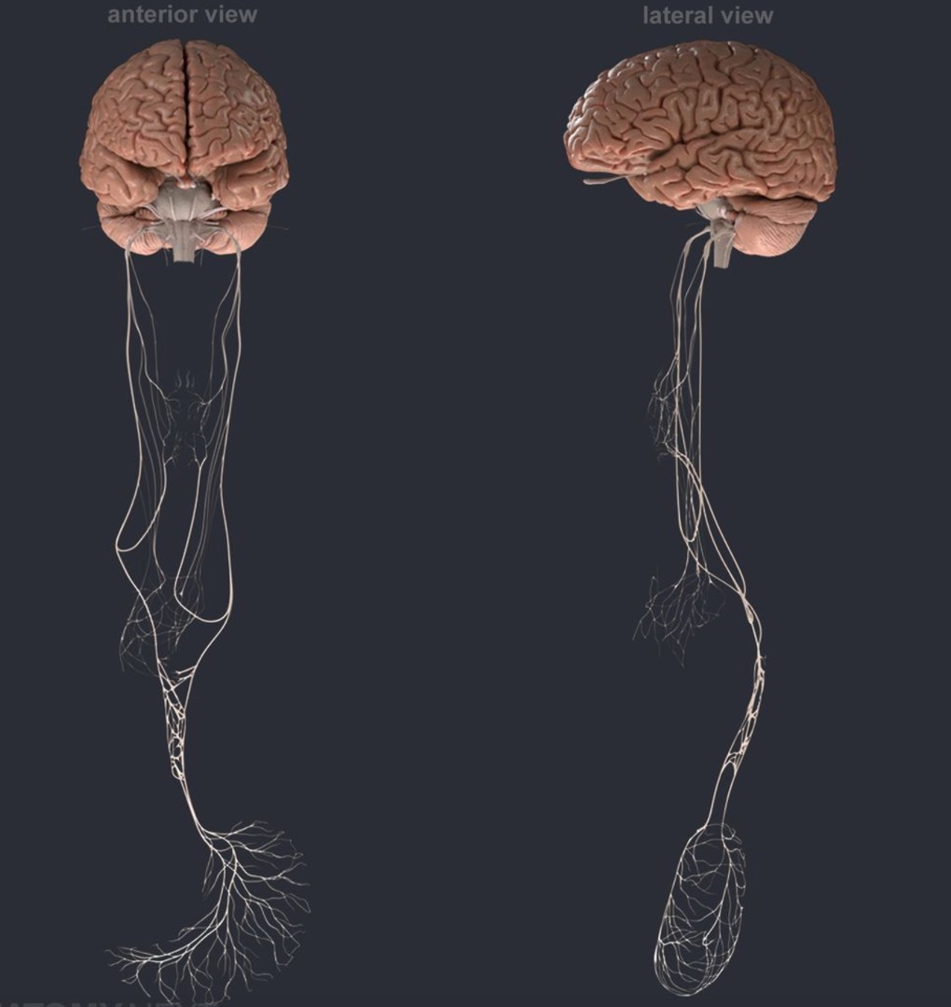
THE METABOLIC ORCHESTRATION
“Energy Intake”
BRAIN FIRST
The Gut–Brain Axis is a
Bidirectional but Hierarchical Communication Network
Linking the Gastrointestinal Tract and the Central Nervous System
The Brain Dictates the Engery Demand
The GUT senses nutrients, harvests energy, and signals the brain – the priority energy recipient - through hormonal and neural pathways.
Stier C, Chiappetta S, Kermansaravi M. A Physiological Model of Incretin-Based Therapies and Hierarchical Energy Allocation Across Metabolic Phenotypes. Diabetes Obes Metab. 2026 Aug;28(8):7652-7657.

Slide 10
THE METABOLIC ORCHESTRATION
“Energy Intake”
BRAIN FIRST
The Gut–Brain Axis is a
Bidirectional but Hierarchical Communication Network
Linking the Gastrointestinal Tract and the Central Nervous System
The Brain Dictates the Engery Demand
The Body Must Meet this Demand
The GUT senses nutrients, harvests energy, and signals the brain – the priority energy recipient - through hormonal and neural pathways.
Stier C, Chiappetta S, Kermansaravi M. A Physiological Model of Incretin-Based Therapies and Hierarchical Energy Allocation Across Metabolic Phenotypes. Diabetes Obes Metab. 2026 Aug;28(8):7652-7657.

Slide 11
THE GUT-BRAIN AXIS – A COMMUNICATION NETWORK IN THE ERA OF OBESITY

Slide 12


THE METABOLIC ORCHESTRATION
“Energy Intake”
BRAIN FIRST
The Gut–Brain Axis is a
Bidirectional but Hierarchical Communication Network
Linking the Gastrointestinal Tract and the Central Nervous System
Genes set the tone, but they don’t play the whole song.
The adipogenic environment turn up the volume and shapes the melody:
ultra-processed foods replace fat with fructose =>
(low insulin output)
The Brain Dictates the Engery Demand
The Body Must Meet this Demand
The GUT senses nutrients, harvests energy, and signals the brain – the priority energy recipient - through hormonal and neural pathways.
Stier C, Chiappetta S, Kermansaravi M. A Physiological Model of Incretin-Based Therapies and Hierarchical Energy Allocation Across Metabolic Phenotypes. Diabetes Obes Metab. 2026 Aug;28(8):7652-7657.

Slide 13
AS A RESULT, THERE IS A MISS-COMMUNICATION FROM GUT-TO BRAIN
WITH THE DEVOLOPEMENT OF ANOTHER EVOLUTION

Slide 14
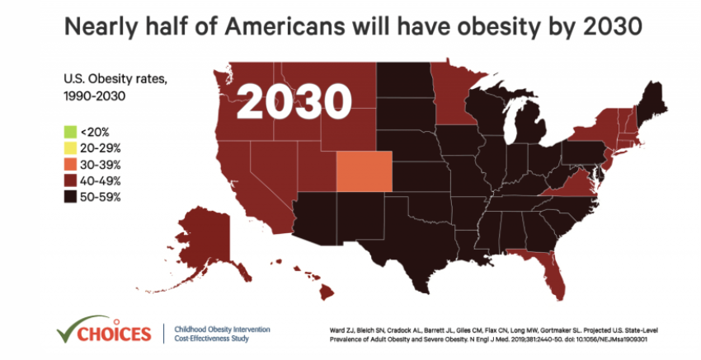
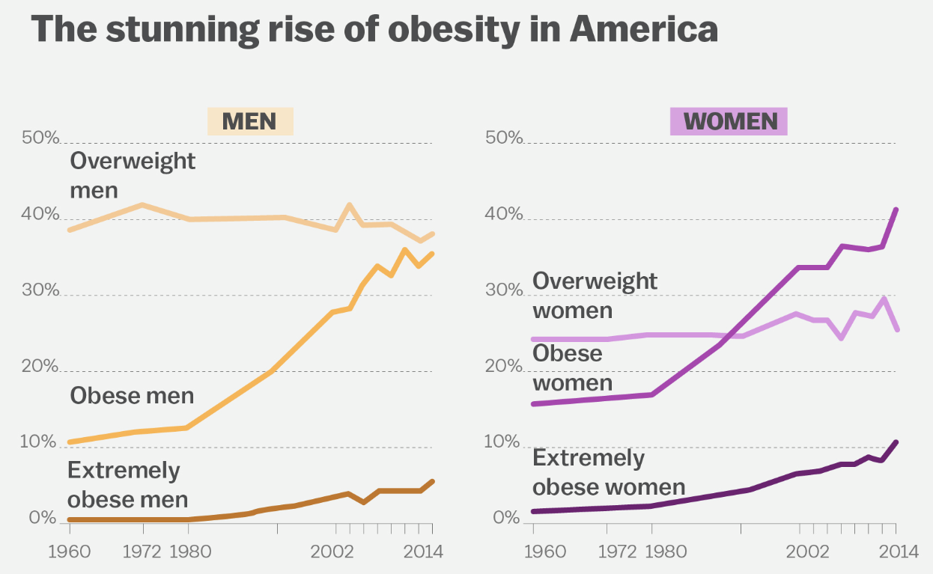
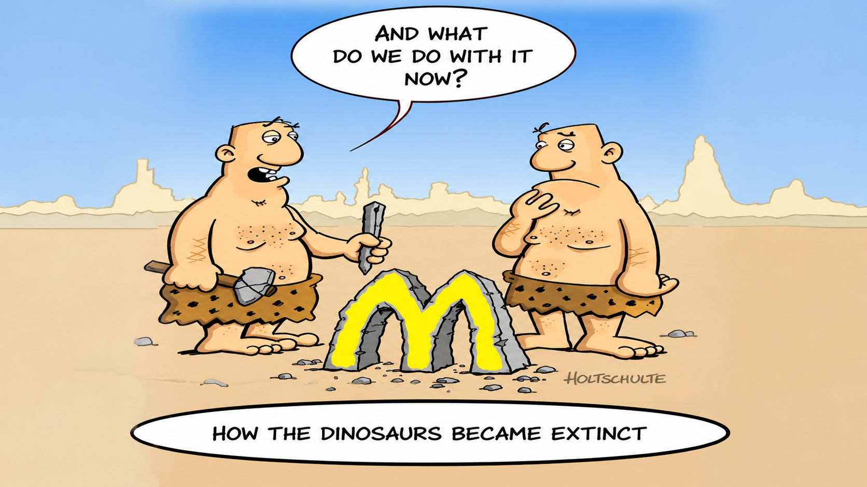
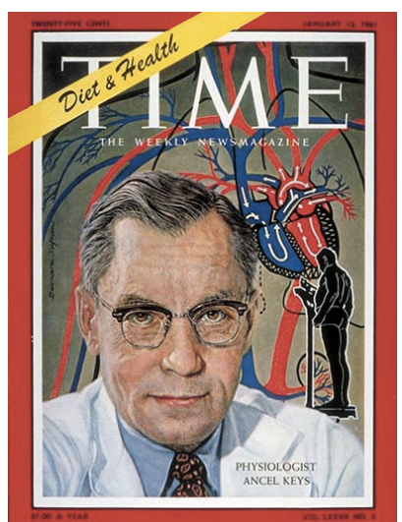
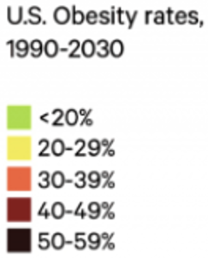
THE OTHER EVOLUTION.
The Disease developed constantly
The Stunning Rise of Obesity in America: 1970 – 2030
THE FIRST LONGEVITY MOVEMENT TO CONTAIN CV RISK: Seven-Country Study
„Low Fat“ & „No Fat“ politics. => led to ultra-processed food.
Fructose substituted fat. Fructose does not release the same amount of insulin like other carbohydrates
„Insulin is the loudest satiation-signal from gut-to-brain“ so, in a way, the signal turns too silent.“

Slide 15

? THE CRITICAL QUESTION ?
RECEIVES THE BRAIN A PROPORTIONAL SIGNAL
TO REDUCE THE DRIVE TO ENERGERY INTAKE (SATIATION => NON-EATING).
OLNY THE INTERVENTIONAL APPROACH TURNS DOWN THE METABOLIC VOLUME
AS IT MODIFYS THE METABOLIC SIGNALS FROM THE GUT TO THE BRAIN
TARGETING THE GUT-TO-BRAIN SIGNALLING,
WHILE CONSERVATIVE THERAPY RELIES ON COGNITION TO OVERRIDE THESE SIGNALS.

Slide 16
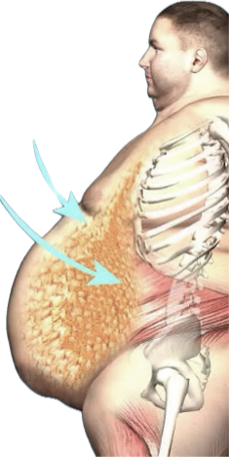
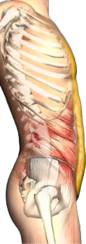


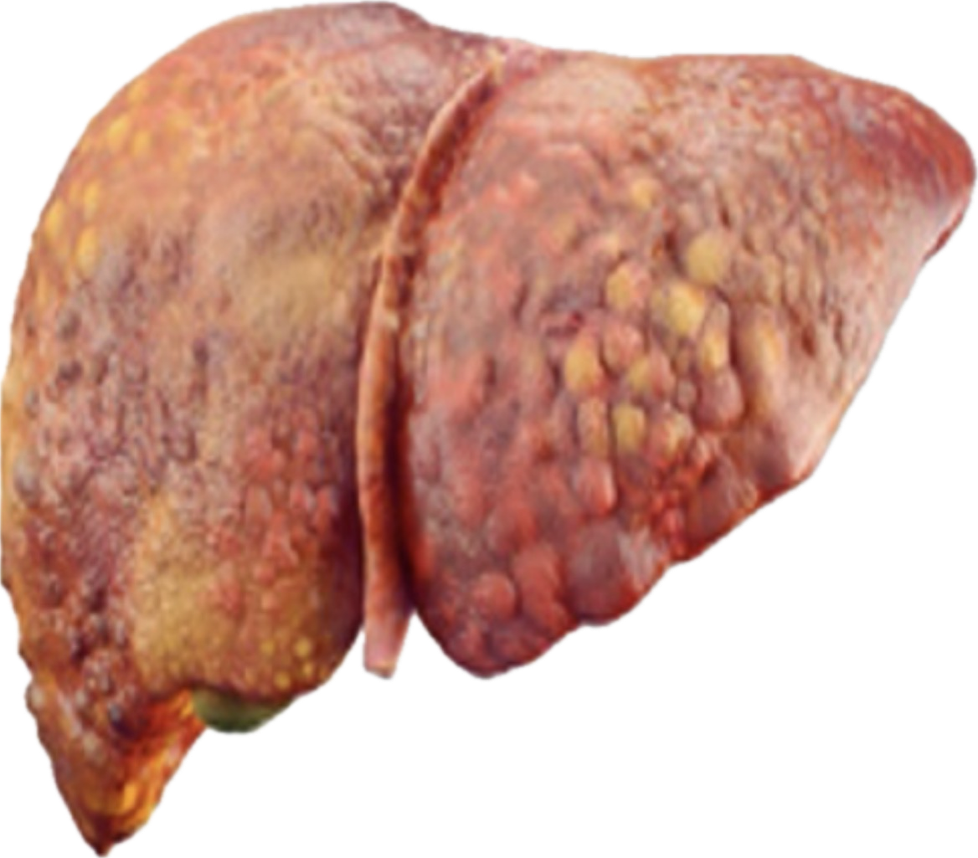
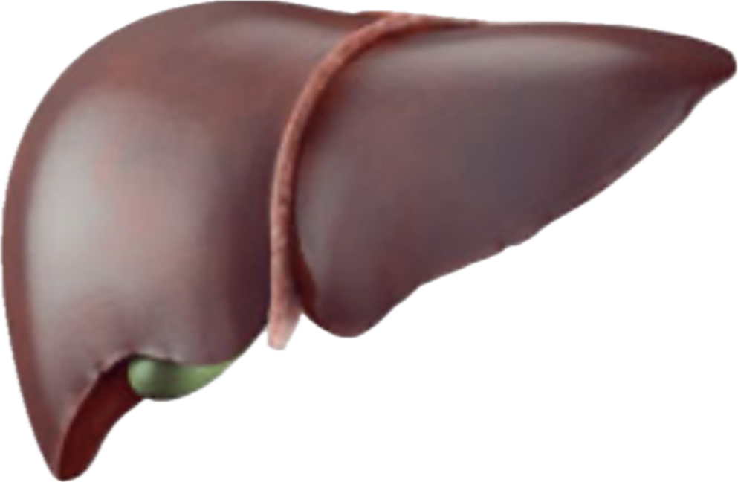
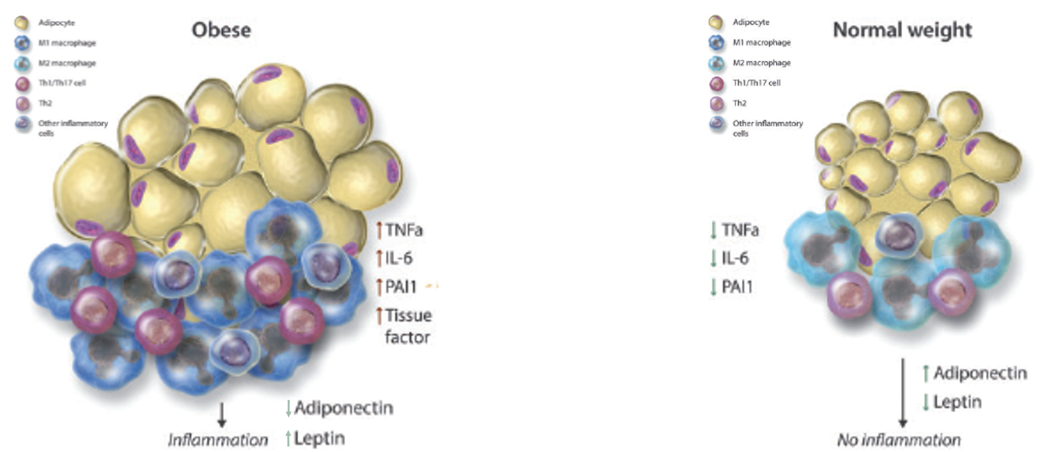
GOALS
OF BARIATRIC AND METABOLIC METABOLIC TREATMENT
Reduction of central obesity
Reduction CV-Risk
Reduktion of hyperinsulinemia
Reduction T2DM / MASH
© Christine Stier
Reduction of chronic inflammation
Reduction of cancer risk
Quality of life (QoL)
Reduction STIGMA
ReductionSTIGMA
Nadolsky et al American Association of Clinical Endocrinology Consensus Statement: Algorithm for the Evaluation and Treatment of Adults with Obesity/Adiposity-Based Chronic Disease - 2025 Update. Endocr Pract. 2025 Nov;31(11):1351-1394.

Slide 17
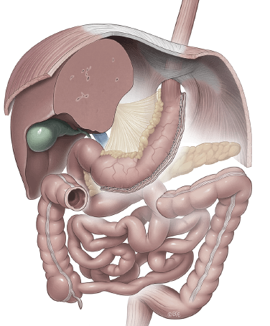
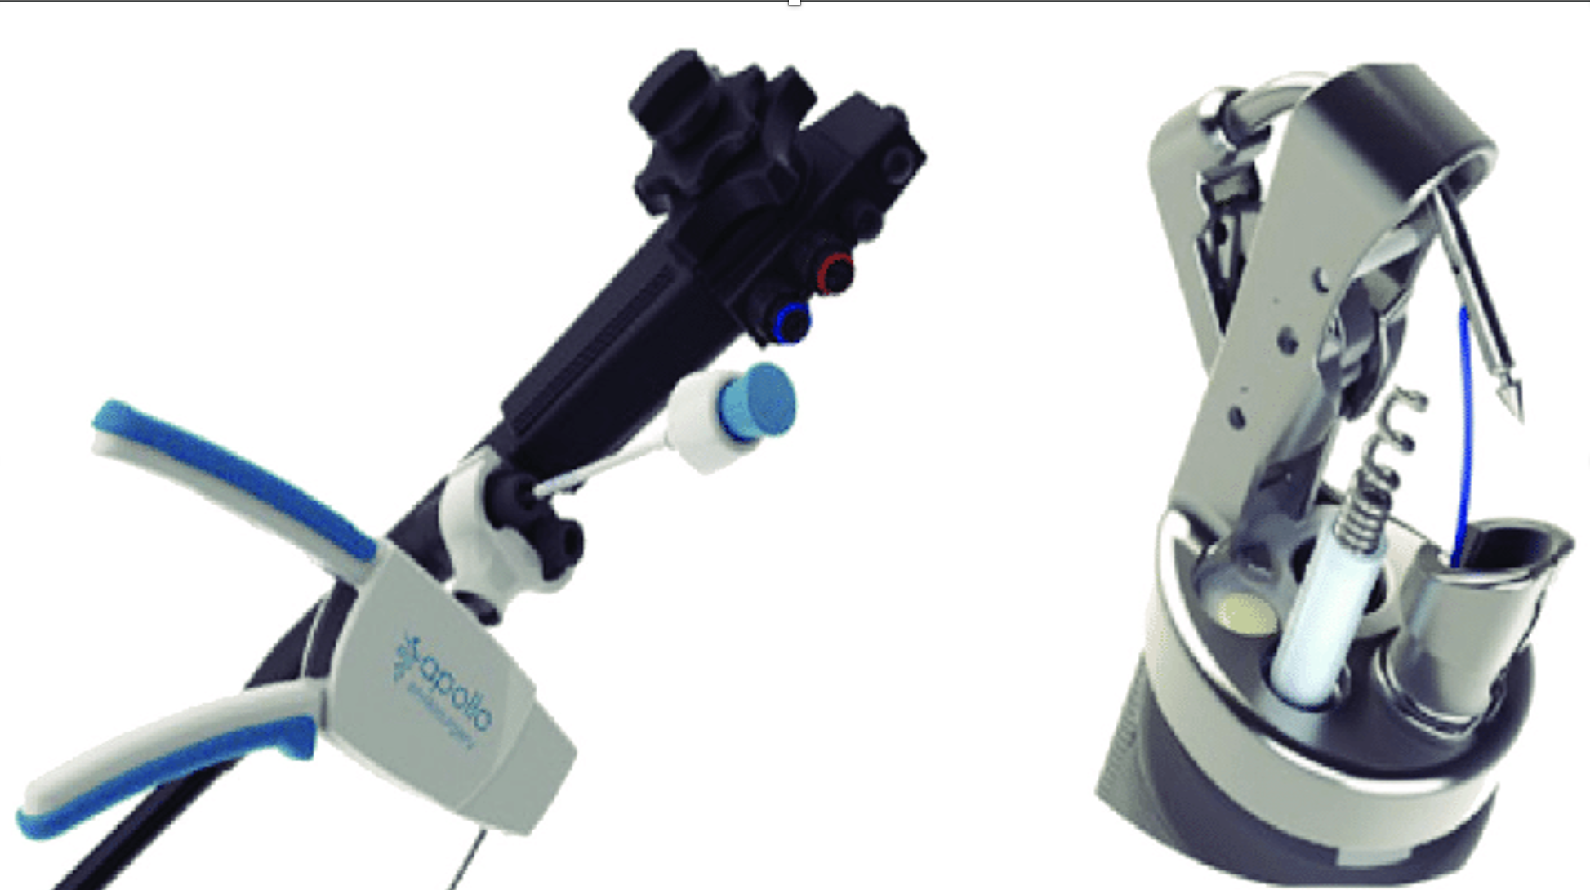
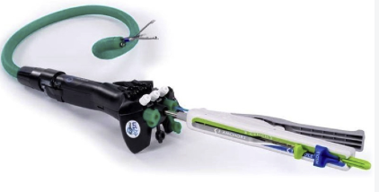
BARIATRIC AND METABOLIC ENDOSCOPY
Treatment Turns the Metabolic Volume Back Down
Gastric Interventions
Overstitch
Boston Scientific
Endoscopic Sleeve Gastroplasty
Incisionless Operating Platform
USGI Medical
Primary Obesity Surgery endoluminal
(POSE)

Slide 18
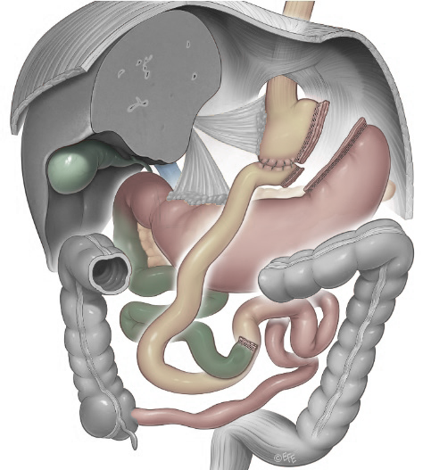
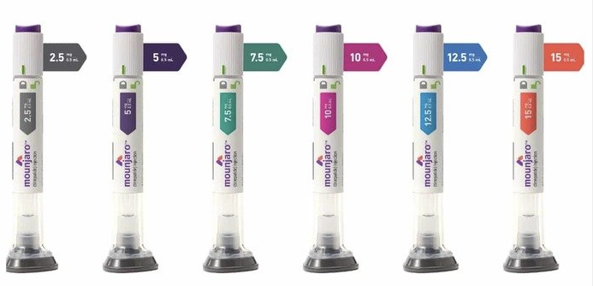
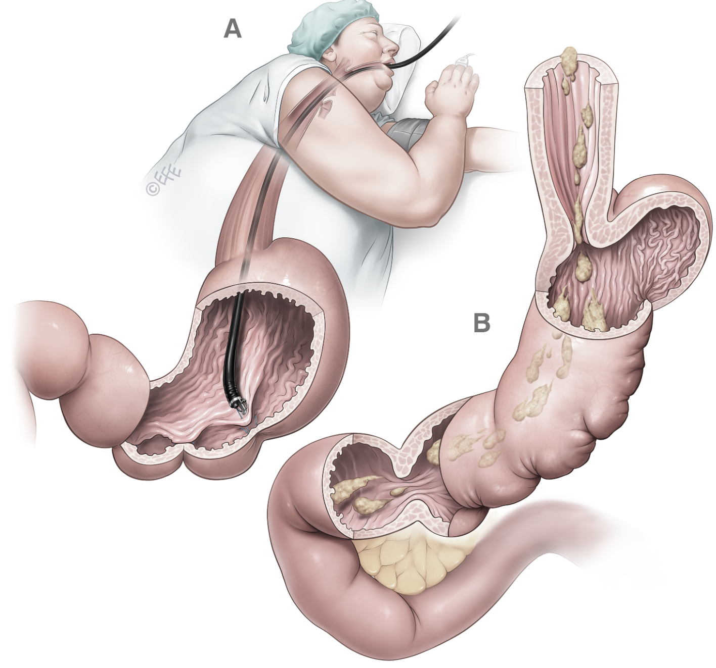

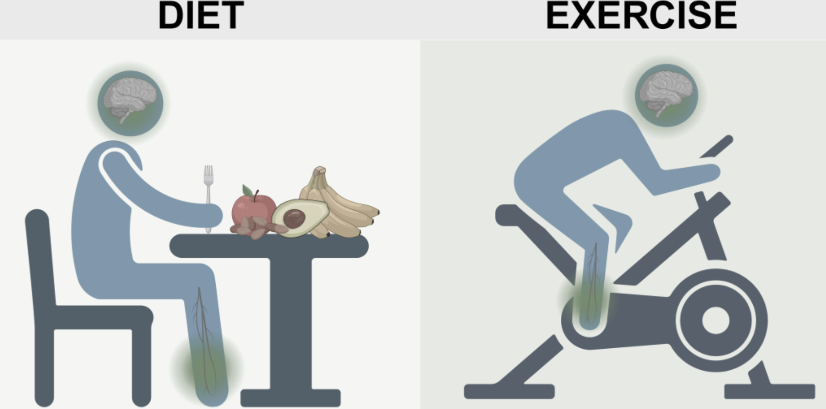
MODULATION-EFFECT OF THE GUT-TO BRAIN SIGNALLING AND RESPECTIVE TREATMENT EFFECT
IF ENERGY INTAKE IS REGULATED BY BIOLOGICAL SIGNALS,
EFFECTIVE OBESITY TREATMENT MUST MODIFY THESE SIGNALS.
VERY EFFECTIVE
as it fundamentally changes the signals from the GUT to the BRAIN
EFFECTIVE
as it does change the signals from the GUT to the Brain
LESS EFFECTIVE
Cognition is asked to continuously override a biological drive without changing the signals that generate it.
MBS
1-2%
of eligible
patients
EFFECT
OMM
EBMT
Lifestyle Changes.
98-99%
unmet
need
Disciplin & Selfregulation
Versus biological signalling WEIGHT LOSS IS NO BIOLOGICAL CONCEPT OF NATURE

Slide 19
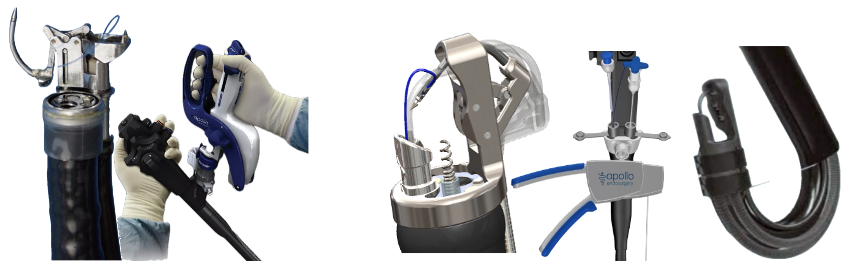
BARIATRIC AND METABOLIC ENDOSCOPY
Develeopment of a sututring tool
First generation:
Eagle Claw; Bulky and not user-friendly
Second generation:
two-channel olympus endoscope compatible
Forth generation: compatible to the most single-channel endoscopes
Enables complete retroflexion

Slide 20
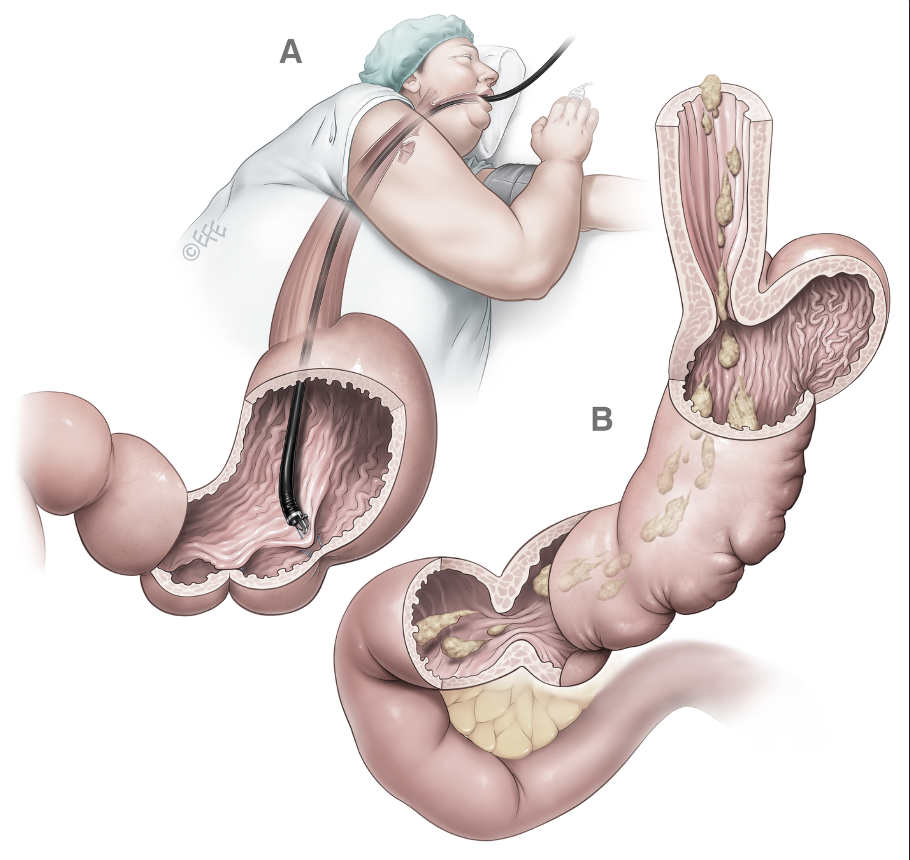
BARIATRIC AND METABOLIC ENDOSCOPY (ESG)
A primary bariatric procedure was developed: Endoscopic Sleeve gastroplasty (ESG)
Abu Dayyeh BK, Rajan E, Gostout CJ. Endoscopic sleeve gastroplasty: a potential endoscopic alternative to surgical sleeve gastrectomy for treatment of obesity. Gastrointest Endosc. 2013 Sep;78(3):530-5.

Slide 21
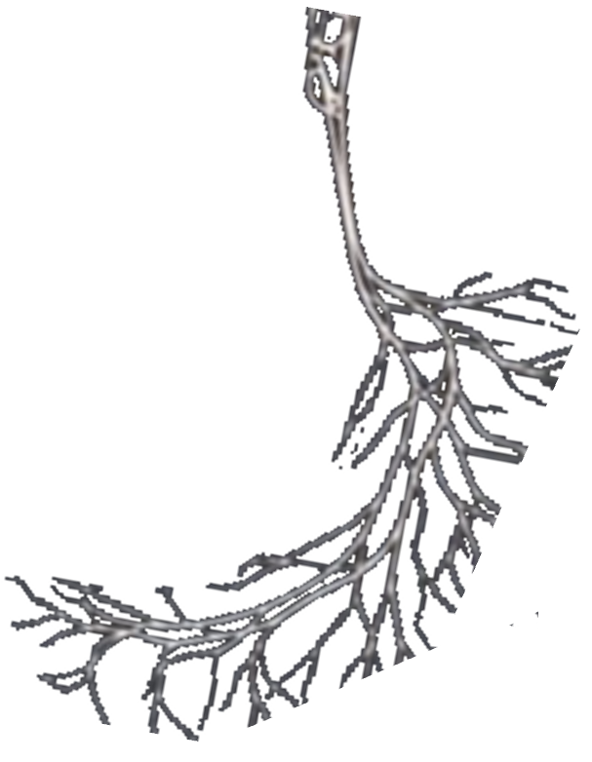
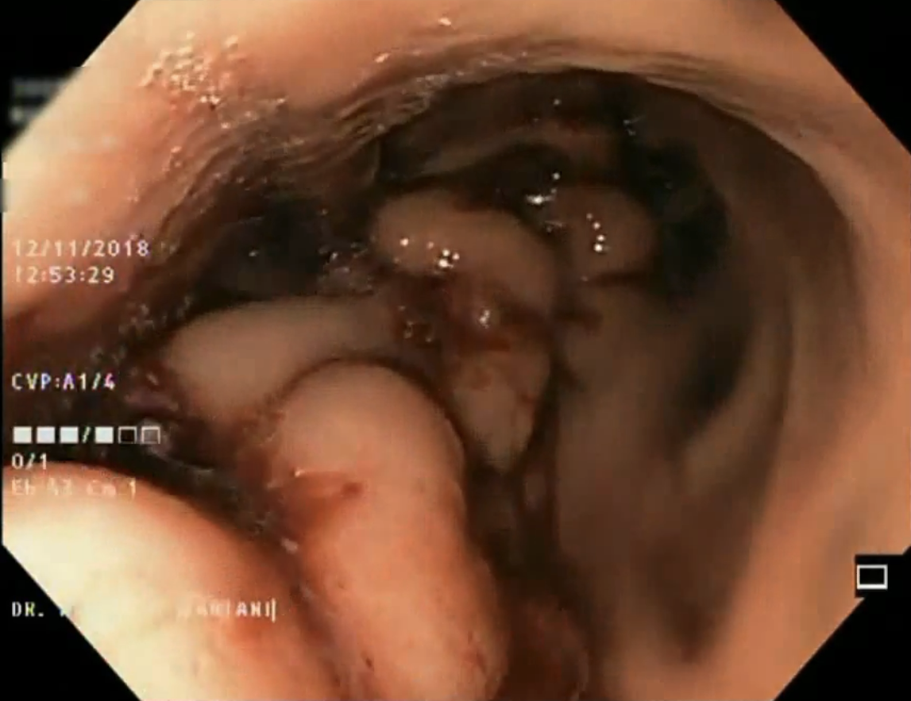
BARIATRIC AND METABOLIC ENDOSCOPY (ESG)
Fundus and Angle of His:
Non-touch technique.
Creates a functional pouch,
promoting a gastric depot effect
delaying gastric emptying
Reduction of gastric
volume
Earlier gastric wall distention activates mechanoreceptors
SUSTAINABILITY. 5-, 10 year data available
PER DEFINITION: ENDOSCOPY IS REPEATABLE
Fig. © Dr Levent Efe, courtesy of IFSO

Slide 22
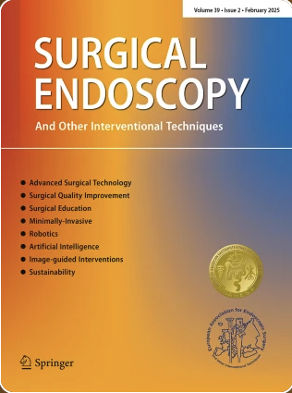
REPEATABILITY DEMONSTRATED
Lopez-Nava G. et al.
Re-suturing after primary endoscopic sleeve gastroplasty (ESG) for obesity.
Surg Endosc. 2021 Jun;35(6):2523-2530.
RESULTS: Of the 482 patients who underwent P-ESG, 35 (7%) required R- ESG (WF-12, WR-12, WP-11). The mean age, weight, BMI (38.2 kg/m²), and the number of sutures used during P-ESG were similar between the groups. The nadir %TBWL was lowest in WF group compared to WR and WP (6.5% vs. 20% vs. 22.4%, p = 0.001). The mean BMI at R-ESG was 33.6 kg/m². The time to R-ESG was longer in the WR group compared to WF and WP (22.3 vs. 13.4 vs. 13.7 months, p = 0.03). We placed a median of 3 (range 2-6) sutures. R-ESG was technically successful, and no serious complications occurred. All except two patients were discharged on the same day. The overall %TBWL achieved by R-ESG was significantly higher in WP (26%) as compared to WF (11.2%) and WR (12%), respectively (p = 0.001).
CONCLUSION: The need for R-ESG after P-ESG is low. R-ESG is safe and induced weight loss in all patients. The maximum benefit was observed in WP.

Slide 23
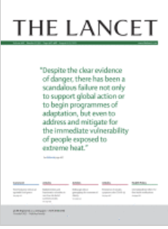
RCT WITH A CROSSOVER DESIGN
Abu Dayyeh BK, et al.
Endoscopic sleeve gastroplasty for treatment of class 1 and 2 obesity (MERIT): a prospective, multicentre, randomised trial.
Lancet. 2022 Aug 6;400(10350):441-451.
FINDINGS: Between Dec 20, 2017, and June 14, 2019, 209 participants were randomly assigned to ESG (n=85) or to control (n=124). At 52 weeks, the primary endpoint of mean percentage of EWL was 49·2% (SD 32·0) for the ESG group and 3·2% (18·6) for the control group (p<0·0001). Mean percentage of total bodyweight loss was 13·6% (8·0) for the ESG group and 0·8% (5·0) for the control group (p<0·0001), and 59 (77%) of 77 participants in the ESG group reached 25% or more of EWL at 52 weeks compared with 13 (12%) of 110 in the control group (p<0·0001). At 52 weeks, 41 (80%) of 51 participants in the ESG group had an improvement in one or more metabolic comorbidities, whereas six (12%) worsened, compared with the control group in which 28 (45%) of 62 participants had similar improvement, whereas 31 (50%) worsened. At 104 weeks, 41 (68%) of 60 participants in the ESG group maintained 25% or more of EWL. ESG-related serious adverse events occurred in three (2%) of 131 participants, without mortality or need for intensive care or surgery.
Conclusion: ESG should be considered as a synergistic weight loss intervention for patients with class 1 or class 2 obesity.

Slide 24
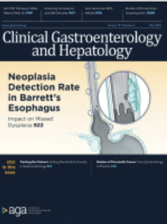
DURABILITY WITH LONG TERM RESULTS DEMONSTRATED
Sharaiha RZ, et al.
Five-Year Outcomes of Endoscopic Sleeve Gastroplasty for the Treatment of Obesity.
Clin Gastroenterol Hepatol. 2021 May;19(5):1051-1057.e2.
RESULTS: 216 patients (68% female) with a mean age of 46±13 years, and mean BMI of 39±6 kg/m² underwent ESG. Out of 216 patients, 203, 96, and 68 patients were eligible for a 1-, 3-, and 5-year follow up, with complete follow-up rates of 70%, 71%, and 82%, respectively. At 5 years, mean TBWL was 15.9% (95% CI, 11.7-20.5, p < .001) and 90 and 61% of patients maintained 5 and 10% TBWL, respectively. There was an overall rate of 1.3% moderate adverse events (AEs), without any severe or fatal AEs.
CONCLUSION: Our results suggest that ESG is safe and effective for treatment of obesity, with durable long-term results for at least up to 5 years after the procedure. This procedure should be considered as a reliable option for treatment of obesity.

Slide 25
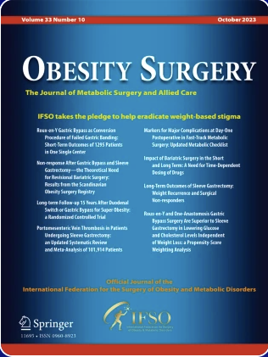
DURABILITY WITH LONG TERM RESULTS DEMONSTRATED
Neto, MG et al.
BACKGROUND: Endoscopic sleeve gastroplasty (ESG) is a minimally invasive endoluminal bariatric procedure, but long-term outcomes beyond 5 years remain limited. This study reports 6-year weight loss, comorbidity outcomes, and safety data from a large single-center cohort. METHODS: This retrospective cohort study included adults undergoing ESG between June 2019 and June 2025 with mean follow up of 3.8 ± 1.4 years. Primary outcomes were percent total weight loss (%TWL) and percent excess weight loss (%EWL) assessed up to 6 years. Secondary outcomes included resolution or improvement of type 2 diabetes mellitus (T2DM), hypertension, obstructive sleep apnea (OSA), and dyslipidemia. Adverse events and revision procedures were recorded. Missing data were handled using multiple imputation by chained equations within an intention-to-treat framework, with sensitivity analyses using non-responder imputation and last-observation-carried-forward methods. RESULTS: A total of 1,377 patients underwent ESG (mean age 41.5 ± 12.2 years; 53.5% female; baseline BMI 35.2 ± 4.8 kg/m²). Mean %TWL was 21.2% (95% CI 20.8–21.6) at 1 year and 14.4% (95% CI 14.0–14.8) at 6 years. Mean %EWL was 56.9% at 1 year and 43.4% at 6 years. At 6 years, resolution or improvement was observed in T2DM (51.2%), hypertension (65.8%), OSA (89.9%), and dyslipidemia (73.6%). There was no mortality. One patient (0.07%) required operative intervention for bleeding. Revision procedures occurred in 5.7% of patients.
CONCLUSIONS: This study shows that ESG produces measurable weight loss and achieves comorbidity improvement through 6 years, with a favourable safety profile and low revision rate. however, prospective comparative studies are needed to define its role relative to surgical and pharmacologic therapies.
Neto MG, et al. Endoscopic Sleeve Gastroplasty: 6-Year Outcomes in 1,377 Patients. Obes Surg. 2026 Mar;36(3):979-987.

Slide 26
META-ANALYSIS: NAFLD
NUNES CMN, et al.
Impact of Endoscopic Sleeve Gastroplasty in Non-alcoholic Fatty Liver Disease: a Systematic Review and Meta-analysis
Obes Surg. 2023 Sep;33(9):2917-2926
RESULTS: Non-alcoholic fatty liver disease (NAFLD) is the most common cause of liver disease worldwide. Endoscopic sleeve gastroplasty (ESG) has proven to be feasible, safe, and effective in the management of obesity. We performed the first systematic review and meta-analysis evaluating NAFLD and other metabolic parameters 12 months post-ESG. Four observational studies with a total of 175 patients were included. The results showed a significant (p < 0.05) reduction of 4.85 in hepatic steatosis index (95% CI - 6.02, - 3.67), 0.5 in NAFLD fibrosis score (95% CI - 0.80, - 0.19), 6.32 U/l in ALT (95% CI - 9.52, - 3.11), 17.28% in TWL (95% CI - 18.24, - 16.31), 6.31 kg/m2 in BMI (95% CI - 8.11, - 4.52), 47.97% in EWL (95% CI - 49.10, - 46.84), and 0.51% in HbA1c (95% CI - 0.90, - 0.12).
CONCLUSION: ESG improves liver parameters, provides weight loss, and reduces HbA1c levels in patients suffering from NAFLD.

Slide 27
META-ANALYSIS: METS
Hanscom M, et al.
Endoscopic Sleeve Gastroplasty for the Treatment of Metabolic Syndrome: A Systematic Review and Meta‐analysis
Obes Surg. 2025 June;35(6):2092-2100
RESULTS: Ten studies with 4320 patients were included. At 12 months, ESG was associated with significant improvements in T2DM, HLD, and HTN, with risk difference of - 0.72 [95% CI, - 0.87 to - 0.58, p < 0.00001], - 0.65 [95% CI, - 0.78 to - 0.52, p < 0.00001], and - 0.60 [95% CI, - 0.66 to - 0.53, p < 0.00001], respectively. Disease improvement was defined as patients being able to stop some or all of their related treatment medications. Additionally, there were significant reductions in hemoglobin A1c (HGBA1c), fasting blood glucose, homeostatic model assessment for insulin resistance (HOMA-IR), low-density lipoprotein, and triglycerides.
CONCLUSION: ESG is an effective modality for the treatment of comorbid T2DM and MetS in patients with obesity. Additional studies are needed to establish long-term responses and to compare ESG against established pharmacologic and surgical techniques.

Slide 28
NARRATIVE REVIEW: ADOLESCENTS
Pelizzo G et al
Adolescent obesity is a growing global health concern, often refractory to conventional interventions. While bariatric surgery remains the most effective treatment, its invasiveness and long-term implications limit its use in pediatric patients. Endoscopic sleeve gastroplasty (ESG) has recently emerged as a minimally invasive alternative. This narrative review aims to provide a comprehensive overview of ESG in adolescents, addressing efficacy, safety, mechanisms of action, comparisons with other therapies, and current guideline recommendations. We conducted a narrative review of studies on ESG in individuals under 21 years of age. Literature searches were performed using PubMed, Scopus, EMBASE, and Web of Science for English-language articles published up to April 2025. Studies were included if they reported on ESG outcomes, safety, mechanisms, indications, or expert consensus. Available pediatric data, primarily from a single-center cohort of 109 adolescents, show a total body weight loss (TBWL) of 14.4% at 6 months, 16.2% at 12 months, and 13.7% at 24 months. ESG demonstrated a favorable safety profile, with minor adverse events (abdominal pain, nausea) in 2-3% and no severe complications or growth impairment. Mechanistically, ESG induces weight loss via gastric restriction and delayed gastric emptying, without altering nutrient absorption or appetite-regulating hormones. Comparisons with other modalities show ESG outperforms lifestyle therapy and pharmacotherapy in TBWL, with fewer complications than laparoscopic sleeve gastrectomy. ESG is cost-effective in class II obesity and may be reversible or combined with medical therapies. Despite promising results, ESG remains supported by Level IV evidence and is recognized in only a few pediatric guidelines. ESG offers a safe, anatomy-preserving, and moderately effective treatment option for adolescents with moderate-to-severe obesity. It may serve as a valuable bridge between conservative therapy and surgery. However, long-term data and randomized controlled trials are needed to define its role within standardized pediatric obesity care pathways.
Pelizzo G, et al. Endoscopic Sleeve Gastroplasty: a Proposal for a Minimal Invasive Endoscopic Approach to Adolescent Obesity. Obes Surg. 2025 Sep;35(9):3926-3938.

Slide 29
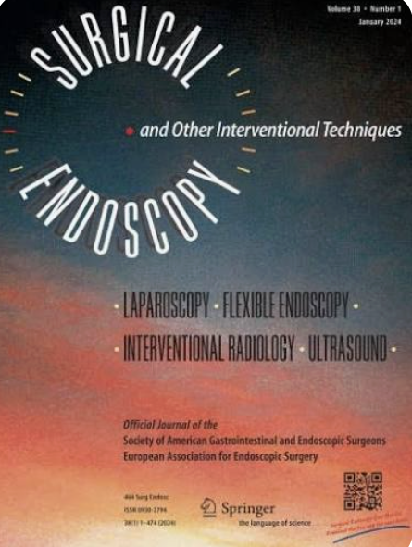
META-ANALYSIS: COMBINATION WITH OMM
De Quadros et al.
Endoscopic sleeve gastroplasty (ESG) is increasingly combined with anti-obesity medications (AOMs), but the incremental benefit of combination therapy over ESG alone remains uncertain METHODS: This systematic review and meta-analysis followed PRISMA guidelines and was registered in PROSPERO (CRD420251179747). Comparative studies evaluating ESG plus AOMs versus ESG alone in adults with overweight or obesity were included. Random-effects models were used for pooled analyses RESULTS: Ten studies comprising 578 participants met inclusion criteria. At approximately seven months, combination therapy showed a modest, non-significant advantage in total weight loss (mean difference +1.9% TWL; 95% CI - 1.22 to 4.99), with substantial heterogeneity (I² ≈ 80-90%).
For metabolic outcomes, the pooled mean difference in HbA1c change was minimal (- 0.04%; 95% CI - 0.37 to 0.28; p = 0.79), and individual studies reported inconsistent effects
CONCLUSIONS: ESG combined with AOMs may enhance early weight loss in selected settings; however, current evidence does not support consistent long-term superiority over ESG alone for weight or glycemic outcomes. Although the available data remain limited and heterogeneous, concomitant therapy may be considered in selected patients rather than as a universally superior strategy. Multicenter randomized trials with standardized pharmacotherapy protocols, longer follow-up, and improved patient stratification are needed to clarify durability, cost-effectiveness, and the subgroups most likely to benefit.
de Quadros LG, et al. Comparison of the concomitant use of anti-obesity medications with endoscopic sleeve gastroplasty versus endoscopic sleeve gastroplasty alone: a systematic review and meta-analysis. Surg Endosc. 2026 Aug;40(8):6508-6527.

Slide 30
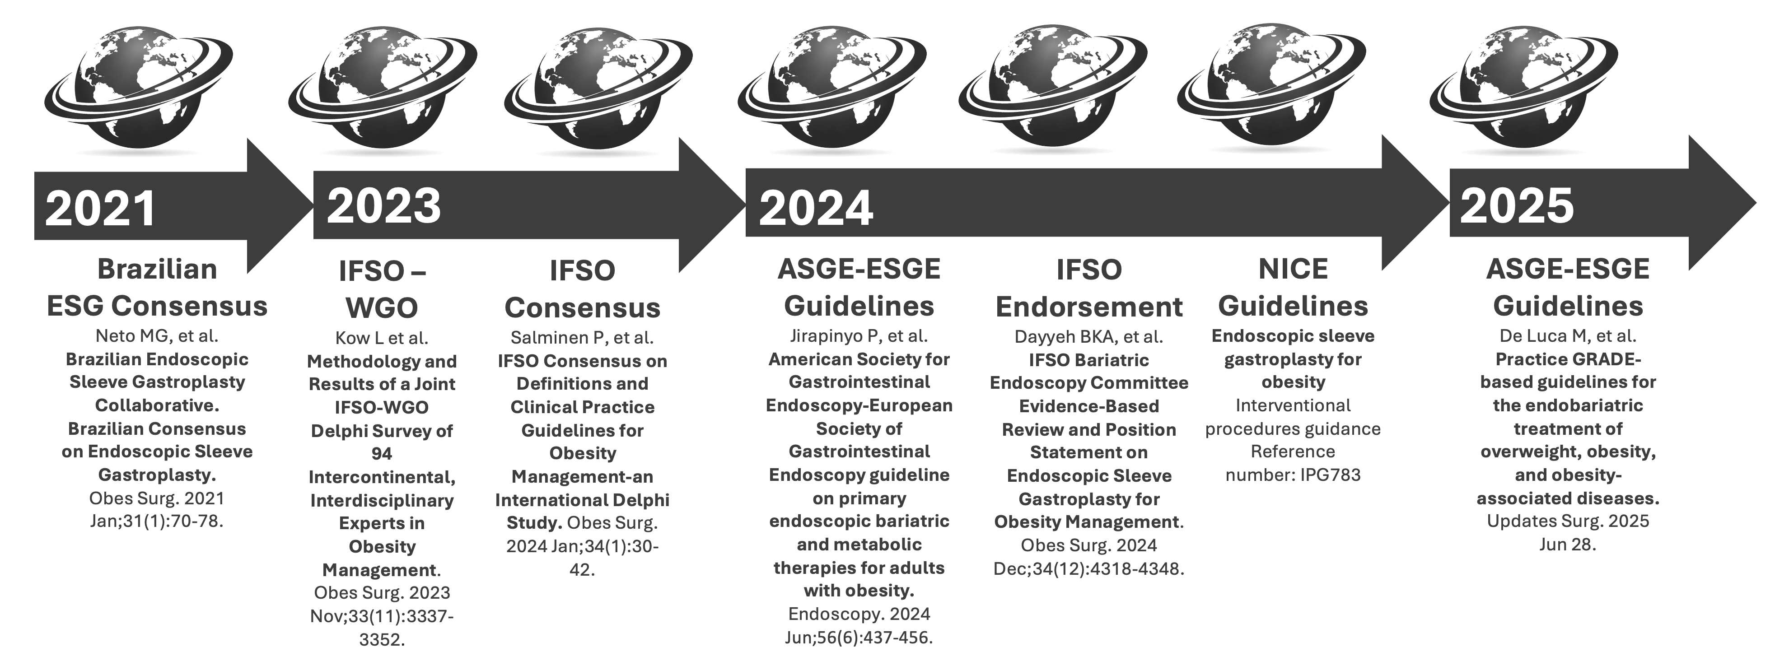
GUIDELINES AND RECOMMENDATIONS
SICOB / SOFFCOM
Guidelines

Slide 31
GUIDELINES AND RECOMMENDATIONS
SICOB / SOFFCOM
Guidelines
Indications:
Class 3 obesity for whom invasive bariatric surgery would be considered high risk or who decline bariatric surgery because of the associated risks and complications
Class 1 or class 2 obesity, for whom the procedure may prevent progression of obesity and associated comorbidities (Self paying market)
Exceptional IFSO: Class 2 obesity in adolescents
After 6 months of failed life style intervention

Slide 32
BARIATRIC AND METABOLIC ENDOSCOPY (ESG)
Meanwhile, the procedure has developed into a cornerstone of modern obesity care: evidence-based, minimally invasive, and highly effective.
Along the greater curvature,
the gastric wall is folded into the lumen using full-thickness running sutures
The U-shaped, transmural sutures interlock like a French braid.

Slide 33
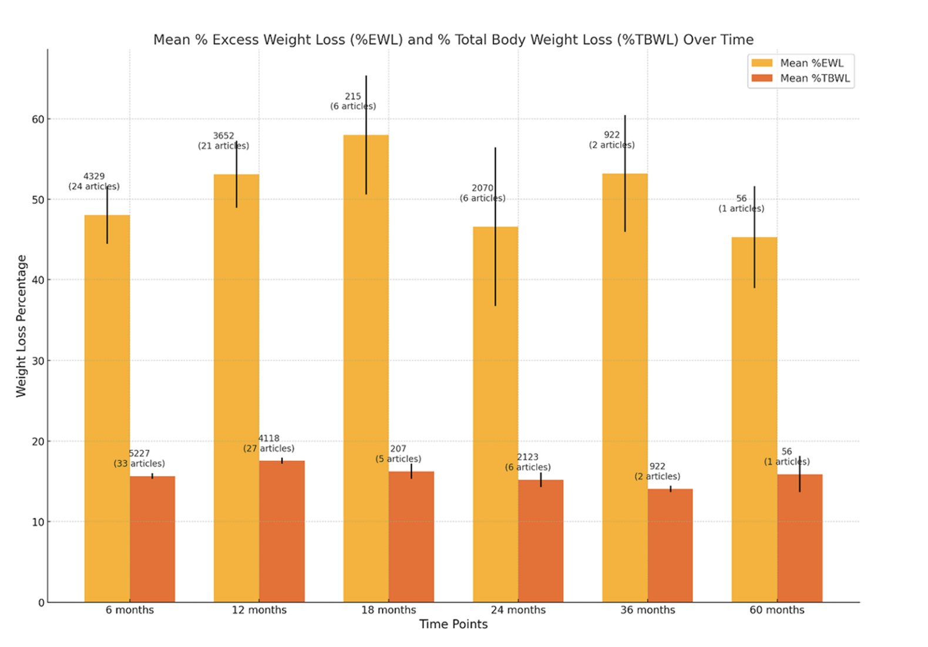
BARIATRIC AND METABOLIC ENDOSCOPY (ESG)
Treatment Turns the Volume Back Down
We already know that it works
The pooled serious adverse event (SAE) rate was 1.25%.
Dayyeh BKA, Stier C, Alqahtani A, Sharaiha R, Bandhari M, Perretta S, Jirapinyo SP, Prager G, Cohen RV. IFSO Bariatric Endoscopy Committee Evidence-Based Review and Position Statement on Endoscopic Sleeve Gastroplasty for Obesity Management. Obes Surg. 2024 Dec;34(12):4318-4348.

Slide 34
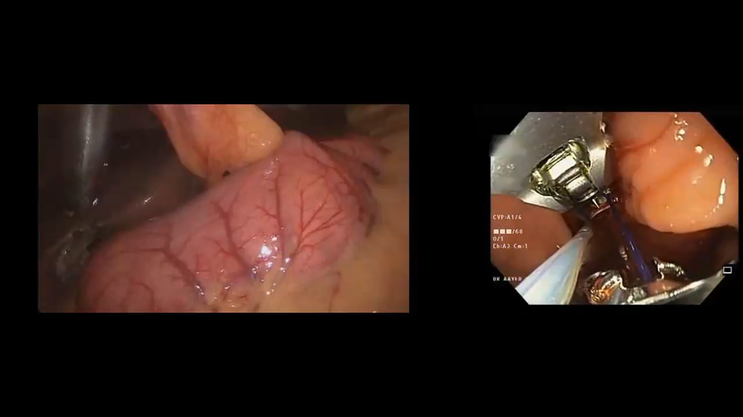
BARIATRIC AND METABOLIC ENDOSCOPY (ESG)
FULL-THICKNESS SUTURES IN U-SHAPED PATTERN
Video @ Courtesy of A. Alqahtani
Fig. © Dr Levent Efe, courtesy of IFSO

Slide 35
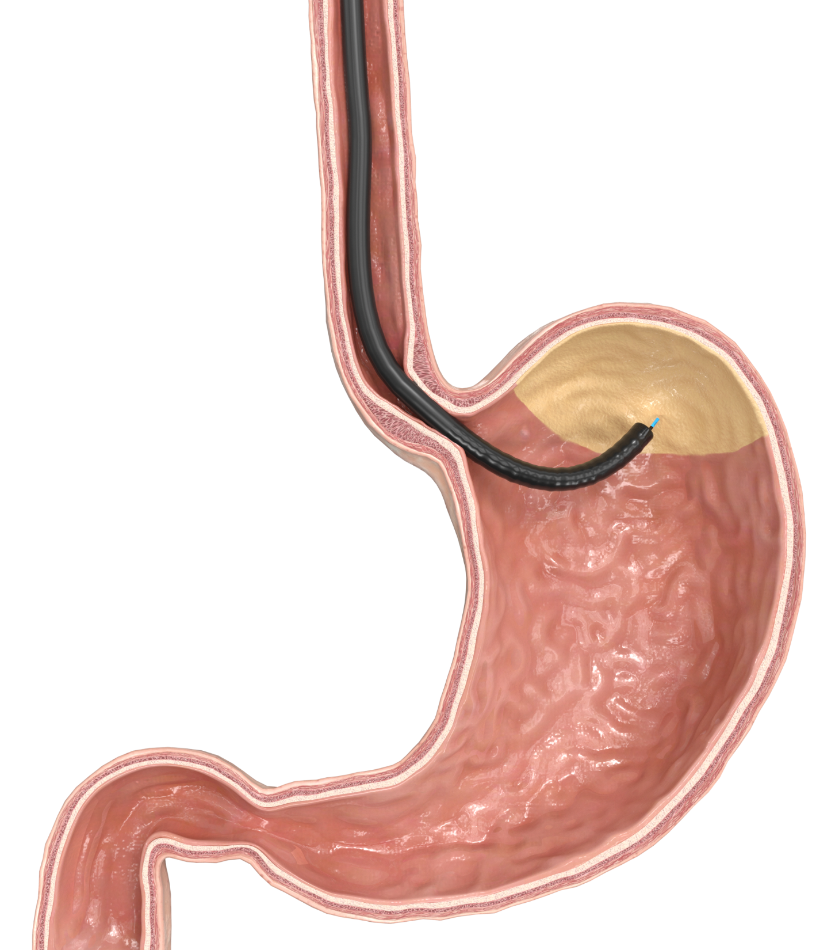
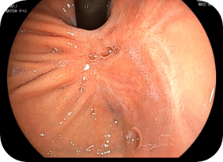
POSSIBLE SUPPLEMTARY THERAPY: GASTRIC MUCOSA ABLATION (GMA)
1. Marking
2. Injection/Lifting
Critical Safety Step
3. Ablation
4. Result
moveAPD 2.0, 0.8 l/min
min 3 ml, effect 25-35
moveAPD 3.0-4.0, 0.8 l/min
2.-3. Repetition

Slide 36
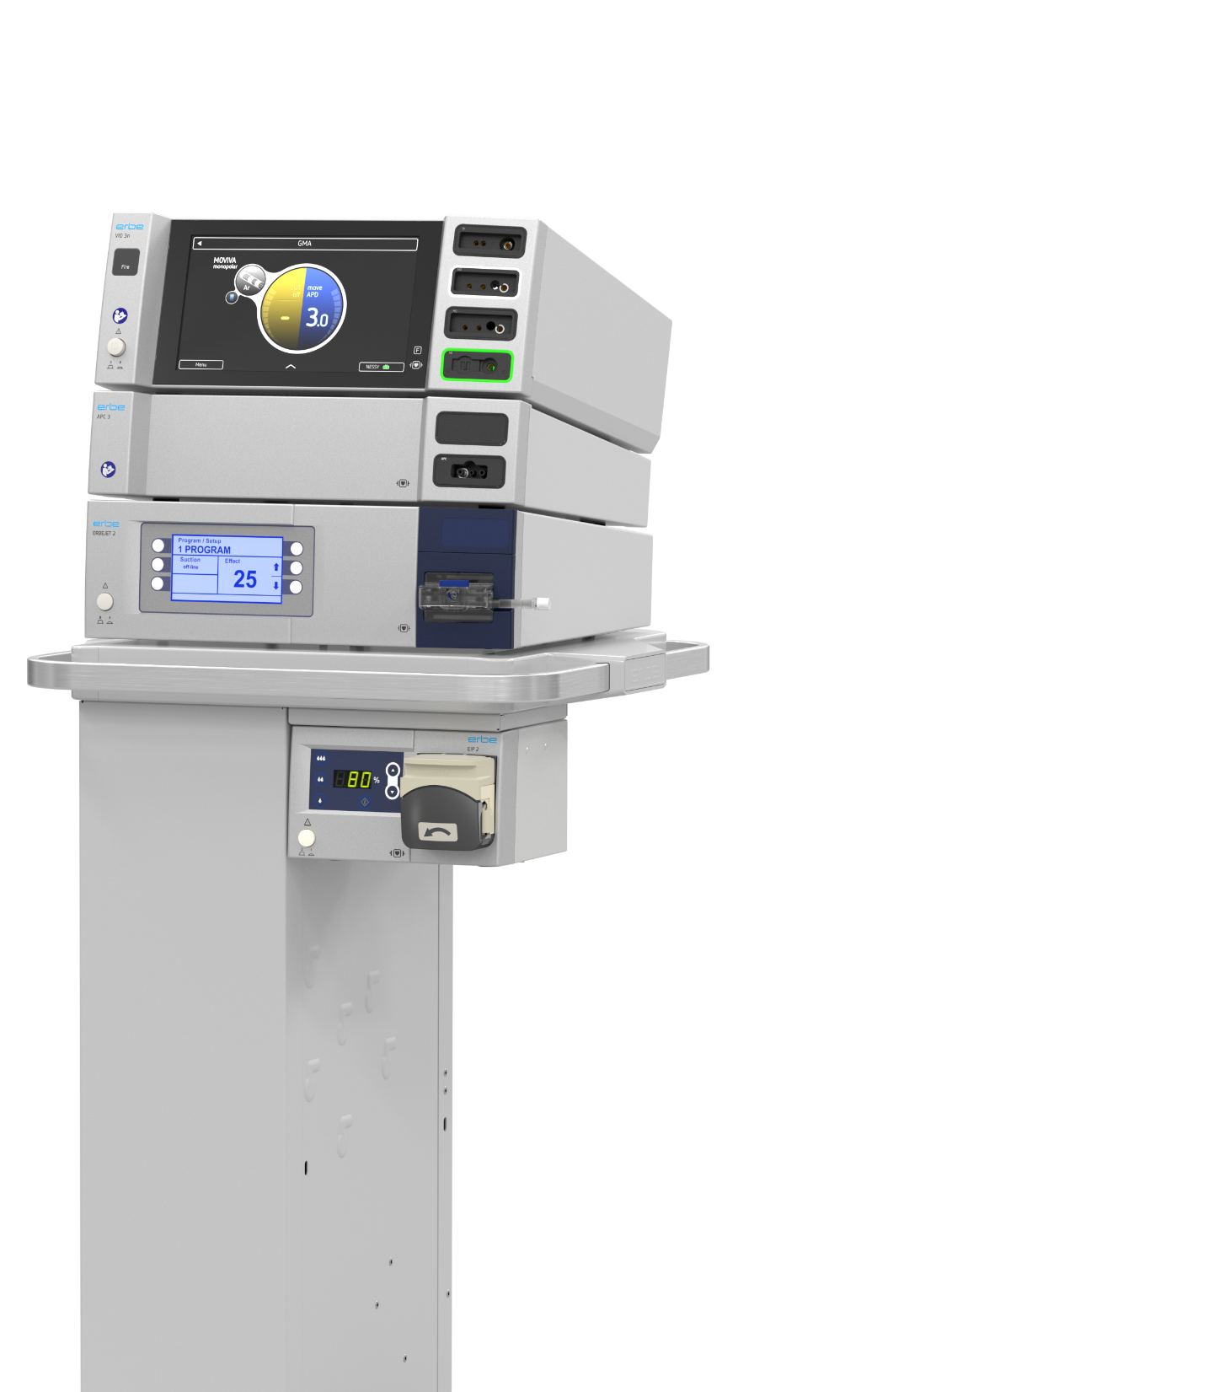
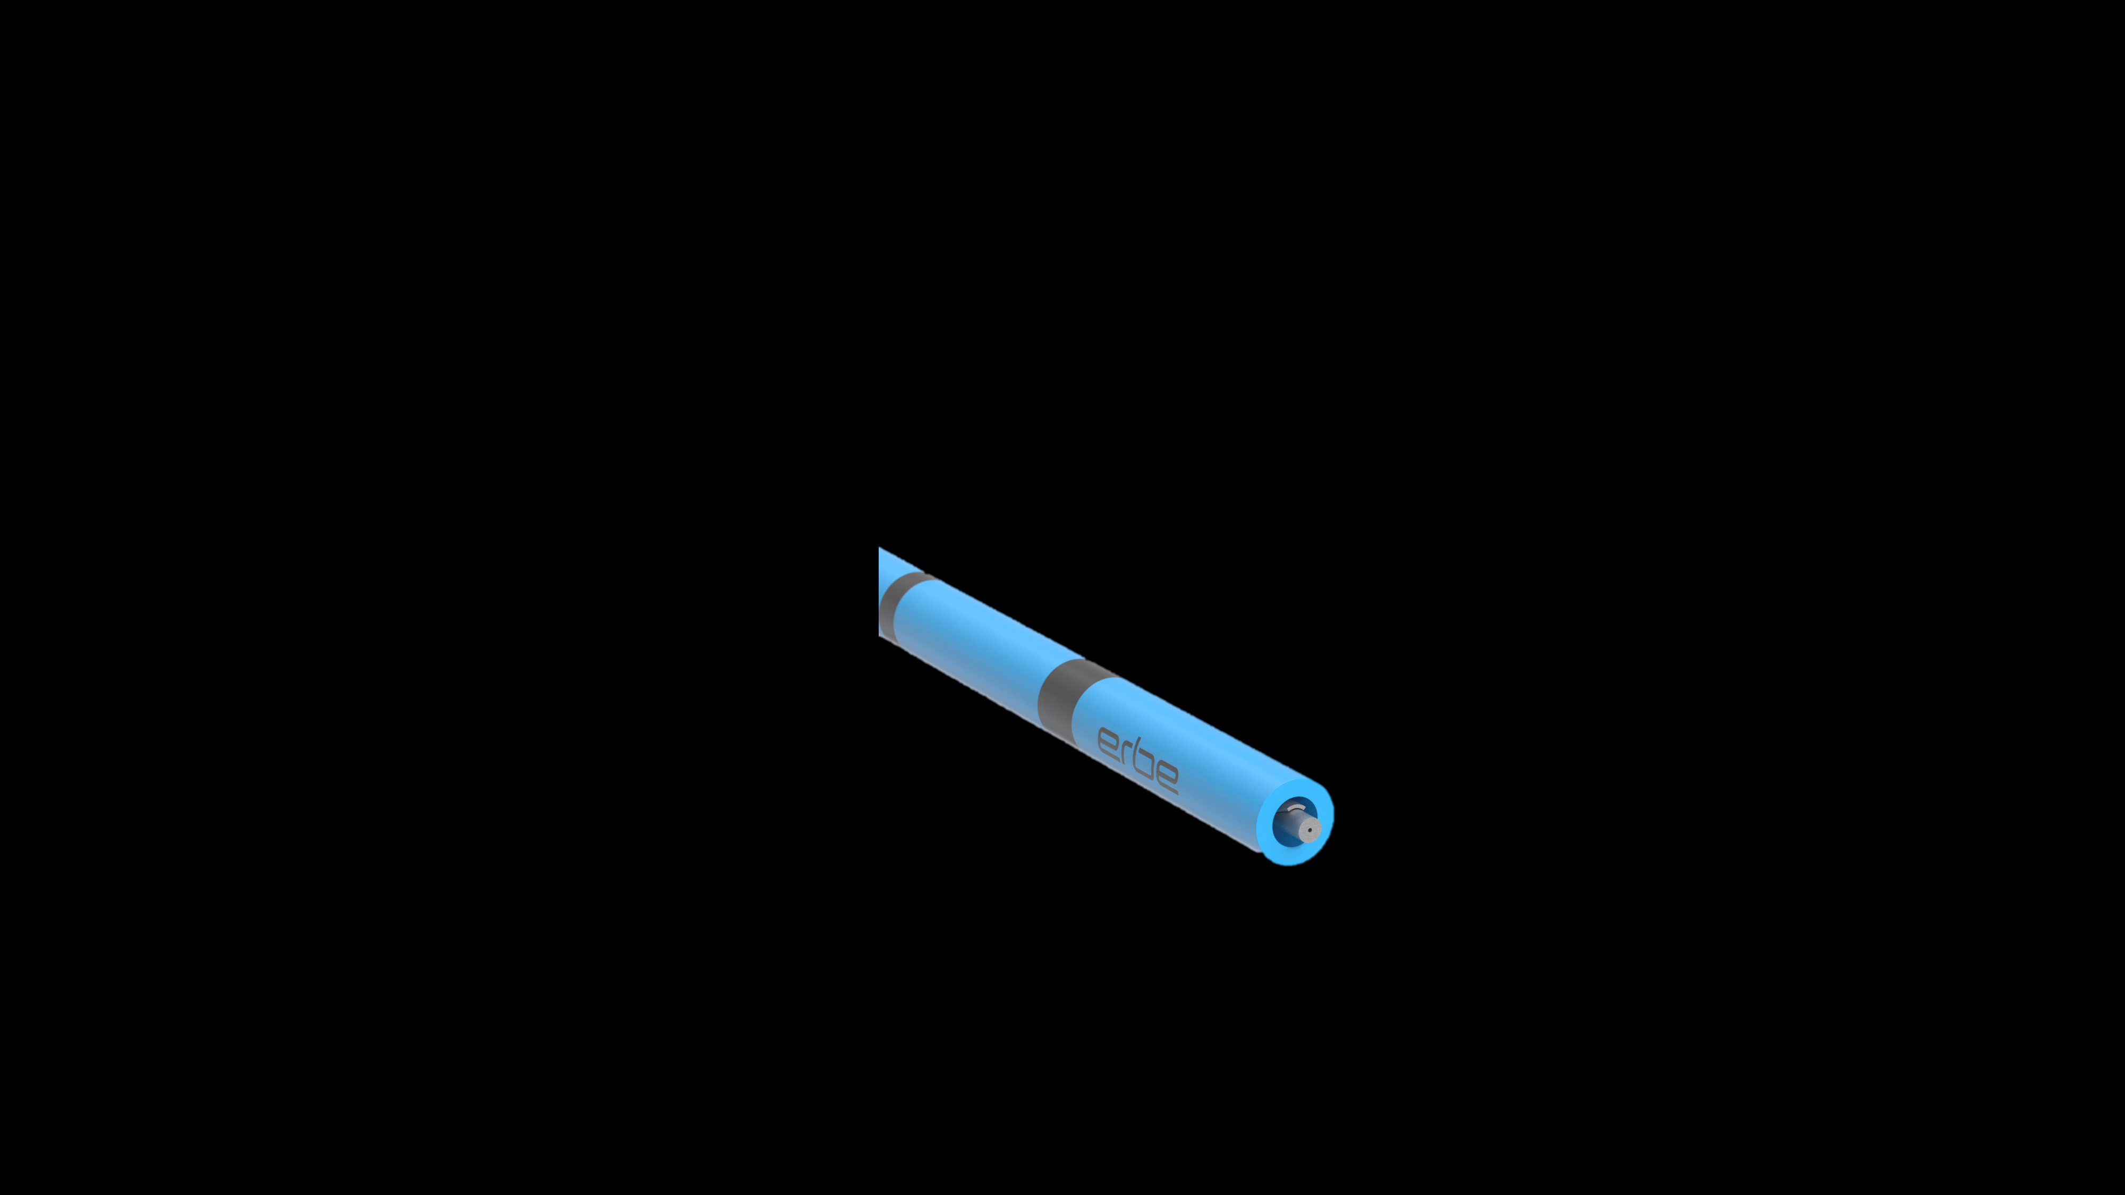
POSSIBLE SUPPLEMTARY THERAPY: GASTRIC MUCOSA ABLATION (GMA)
Superficial ablation with dedicated moveAPD mode
APC allows effective and superficial thermal ablation of mucosa
Needle-free enhanced injection
Tissue is displaced and/or expanded by the fluid not by mechanical puncture of the applicating device (e.g. a needle).
Enhanced injection especially in tangential application
Marking ring at 10 mm
Electrode length 0.75 mm
120µm nozzle

Slide 37




POSSIBLE SUPPLEMTARY THERAPY: GASTRIC MUCOSA ABLATION (GMA)
1 Trial
GMA & ESG
4 Trials
1 Stand alone GMA
2 GMA & ESG
1 Trial
Stand alone GMA
1 Trial
Stand alone GMA

Slide 38
POSSIBLE SUPPLEMTARY THERAPY: GASTRIC MUCOSA ABLATION (GMA)
GMA procedure | fGMA | GMA fundus+corpus | GMA fundus+corpus | GMA fundus+corpus | ESG+fGMA Simultaneous | fGMA+ESG Sequential | fGMA+ESG Simultaneous
Follow-up | 6 months | 6 months | 6 months | 6 months | 12 months | 12 months | 18 months
Trial Name | ABL. WGHT 1 | COMET-2 | GMA-AU | GMA-BRA | FULLNESS | ABL. WGHT 1 | ABL. WGHT 2
Sample | 10 | 15 | 15 | 15 | 25 | 10 | 10
Recruited | 10 | 15 | 15 | 13 | 25 | 10 | 10
Finished follow-up | 10 | 10 | 13 | 6 | 15 | 10 | 10
%TBWL | 7.7 %95 CI: 2.9-13.0 | 9.6 %95 CI: 4.6-14.4 | 8.0 %95 CI: 4.2-15.3 | 8.5 %95 CI: 3.0-12.7 | 27.2 %95 CI: 25.0-29.3 | 20.0 %95 CI: 16.6-28.4 | 23.5 %95 CI: 19.4-27.6
POOLED MEAN (n= 35) : 24.1 %TBWL (95% CI: 21.9% to 26.32%

Slide 39
THE CLASH OF TIMELINES
BIOLOGICAL ADAPTION VS. ALGORITHMIC OPTIMIZATION
THE BIOLOGICAL CLOCK
(MILLIONS OF YEARS)
HUMAN METABOLISM, FINELY TUNED OVER MILLENNIA TO STORE ENERGY
BUT
COMPLETELY UNEQUIPPED FOR THE RAPID SHIFTS OF THE 20TH AND 21ST CENTURY
THE HYPERFAST EVOLUTION
(DAYS TO YEARS)
DIGITAL AI: ALGORITHMIC LEARNING LOOPS
THAT OPTIMIZE AND BREAK THROUGH BOUNDARIES IN REAL TIME
CHEMICAL AI (INCRETINES): MOLECULES PERFECTLY OPTIMIZED IN HIGH-THROUGHPUT SCREENS TO BYPASS THE EVOLUTION AND „HACK” THE BRAINSTEM
Notes:
Ladies and Gentlemen, when we discuss the future of bariatric therapy, we must address the fundamental problem of our era: time.
Human Biology is the product of an incredibly slow evolution, spanning millions of years. Today, this slow biology is colliding with a completely new form of evolution: hyper-fast mathematical optimization in the lab. The metaophic picture is Artificial Intelligence: the new weight-loss drugs, such as incretine-agonists-are exactly that: biological algorithms perfectly optimized in the lab.
The explosive global hype surrounding this medications is, in essence, - Intended or not - the first real-world escape of an artificially optimized system into the global population. It is shifting human behavoir faster than any biological evolution ever could.

Slide 40
ARCHITECTURAL REWRITING vs „CHEMICAL AI“
THE GASTROPLASTY
(MODIFICATION OF THE „HARDWARE“)
REWRITING (REMODELLING) THE PHYSICAL ARCHITECTURE
TO REPROGRAM EVOLUTIONARILY CONSERVED SIGNALING
OBESITY MANAGEMENT MEDICATION
(MODIFICATION OF THE „SOFTWARE“)
THE INFORMTION ABOUT THIS DRUGS WENT VIRAL, AND WITH IT, THE THERAPY MOVED BEYOND THE PROTECTED SPACE OF MEDICINE (ESCAPE?).
LIKE AI, ONCE RELEASED INTO A GLOBAL NETWORK, THE SPEED OF DISSEMINATION BECAME UNPRECEDENTED
! HOWEVER; LET‘S HOPE FOR THE BEST !
Notes:
With gstroplsty we achieve a deliberate mechanical remodelling, based on biological regulation
Human Biology is the product of an incredibly slow evolution, spanning millions of years. Today, this slow biology is colliding with a completely new form of evolution: hyper-fast mathematical optimization in the lab. The metaophic picture is Artificial Intelligence: the new weight-loss drugs, such as incretine-agonists-are exactly that: biological algorithms perfectly optimized in the lab.
The explosive global hype surrounding this medications is, in essence, - Intended or not - the first real-world escape of an artificially optimized system into the global population. It is shifting human behavoir faster than any biological evolution ever could.

Slide 41
TAKE HOME
THE INTERVENTIONAL TARGET OF ENDOSCOPIC GASTROPLASTY IS THE STOMACH (IMPACTION ON GUT-TO-BRAIN SIGNALLING): FULL-THICKNESS ENDOLUMINAL SUTURING ALONG THE GREATER CURVE TO REDUCE GASTRIC VOLUME

Slide 42
TAKE HOME
THE INTERVENTIONAL TARGET OF ENDOSCOPIC GASTROPLASTY IS THE STOMACH (IMPACTION ON GUT-TO-BRAIN SIGNALLING): FULL-THICKNESS ENDOLUMINAL SUTURING ALONG THE GREATER CURVE TO REDUCE GASTRIC VOLUME
OMMs APPEAR LIKE BIOCHEMICAL ALGORITHMS,
OPTIMIZED AT A SPEED THAT BIOLOGICAL EVOLUTION COULD NEVER MATCH.
AN ANALOGY MIGHT BE A „REAL-WORLD-ESCAPE“ OF AN OPTIMIZED ALGORITHM.
ONCE RELEASED, THIS HIGHLY DYNAMIC SYSTEM TAKES THE WORLD BY STORM.

Slide 43
TAKE HOME
THE INTERVENTIONAL TARGET OF ENDOSCOPIC GASTROPLASTY IS THE STOMACH (IMPACTION ON GUT-TO-BRAIN SIGNALLING): FULL-THICKNESS ENDOLUMINAL SUTURING ALONG THE GREATER CURVE TO REDUCE GASTRIC VOLUME
OMMs APPEAR LIKE BIOCHEMICAL ALGORITHMS,
OPTIMIZED AT A SPEED THAT BIOLOGICAL EVOLUTION COULD NEVER MATCH.
AN ANALOGY MIGHT BE A „REAL-WORLD-ESCAPE“ OF AN OPTIMIZED ALGORITHM.
ONCE RELEASED, THIS HIGHLY DYNAMIC SYSTEM TAKES THE WORLD BY STORM.
HOWEVER, A PERSONALIZED APPROACH WILL DETERMINE
WHO BENEFITS FROM ESG ALONE,
WHO REQUIRES COMBINATION WITH OMM,
AND WHO MAY BENEFIT FROM ADDITIONAL ENDOSCOPIC THERAPIES.

Slide 44
TAKE HOME
THE INTERVENTIONAL TARGET OF ENDOSCOPIC GASTROPLASTY IS THE STOMACH (IMPACTION ON GUT-TO-BRAIN SIGNALLING): FULL-THICKNESS ENDOLUMINAL SUTURING ALONG THE GREATER CURVE TO REDUCE GASTRIC VOLUME
OMMs APPEAR LIKE BIOCHEMICAL ALGORITHMS,
OPTIMIZED AT A SPEED THAT BIOLOGICAL EVOLUTION COULD NEVER MATCH.
AN ANALOGY MIGHT BE A „REAL-WORLD-ESCAPE“ OF AN OPTIMIZED ALGORITHM.
ONCE RELEASED, THIS HIGHLY DYNAMIC SYSTEM TAKES THE WORLD BY STORM.
HOWEVER, A PERSONALIZED APPROACH WILL DETERMINE
WHO BENEFITS FROM ESG ALONE,
WHO REQUIRES COMBINATION WITH OMM,
AND WHO MAY BENEFIT FROM ADDITIONAL ENDOSCOPIC THERAPIES.
THEREFORE, THE ULTIMATE MISSION OF BARIATRIC ENDOSCOPY MUST BE TO PROVIDE AN UNSHAKABLE PHYSICAL FOUNDATION FOR LONG-TERM METABOLIC STABILITY BY MODULATING GUT-TO-BRAIN SIGNALLING,
EITHER AS A STAND-ALONE THERAPY
OR IN COMBINATION WITH OTHER TREATMENTS.

Slide 45
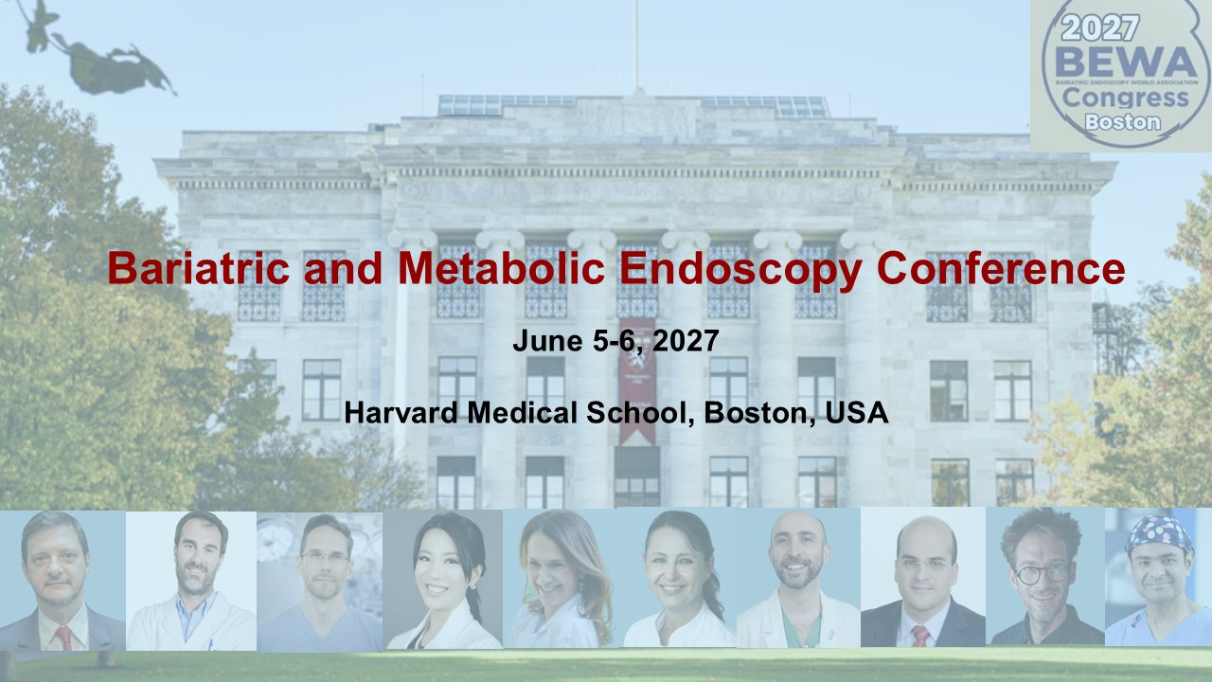

Slide 46

„I look through a half opened door into the future,
Full of interest,
intriguing beyond my power to discribe.“
William J. Mayo, MD
1931
THANK YOU

